Slide 1
Process controll –Hyperdrive Project
Joachim Raffaele Bono Elise Høimyr Séverine Oppliger
Group D

Slide 2
Demo
TODO: insert a video in case it doesn’t work

Slide 3

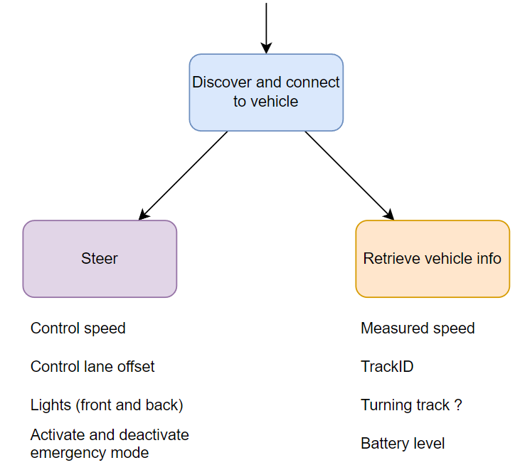

System Overview
SUBSCRIPTIONS
PUBLICATIONS
Host discovering status
Host vehicles status
Target vehicle status
If false, send discover intent : true
2 threads

Slide 4














Java Implementation
MVC design pattern
Thread
Steer
Wished speed
Wished lane offset
Front lights / Back lights
Emergency status
On
Off
MQTT
Emergency
Model
Controller
View
Measured speed
Turning status
Current track id
Battery level
Retrieve vehicle info
MQTT

Slide 5
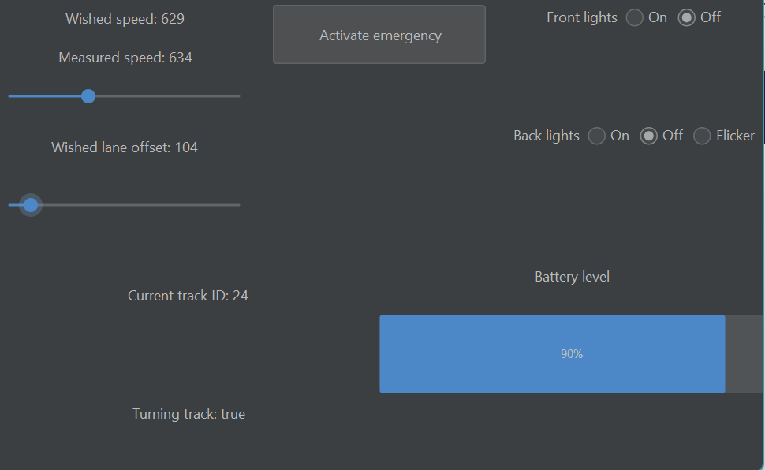

GUI
Python (uses Tkinter)
Java (uses Swing)

Slide 6
Difficulties
The sliders which publish also when the mouse is not released
Battery status is not really reliable (shows 80 when battery is fast empty)

Slide 7
Could be added
A listener on the Java implementation to a «emergency» topic to be informed if another user activates emergency.

